Slide 1
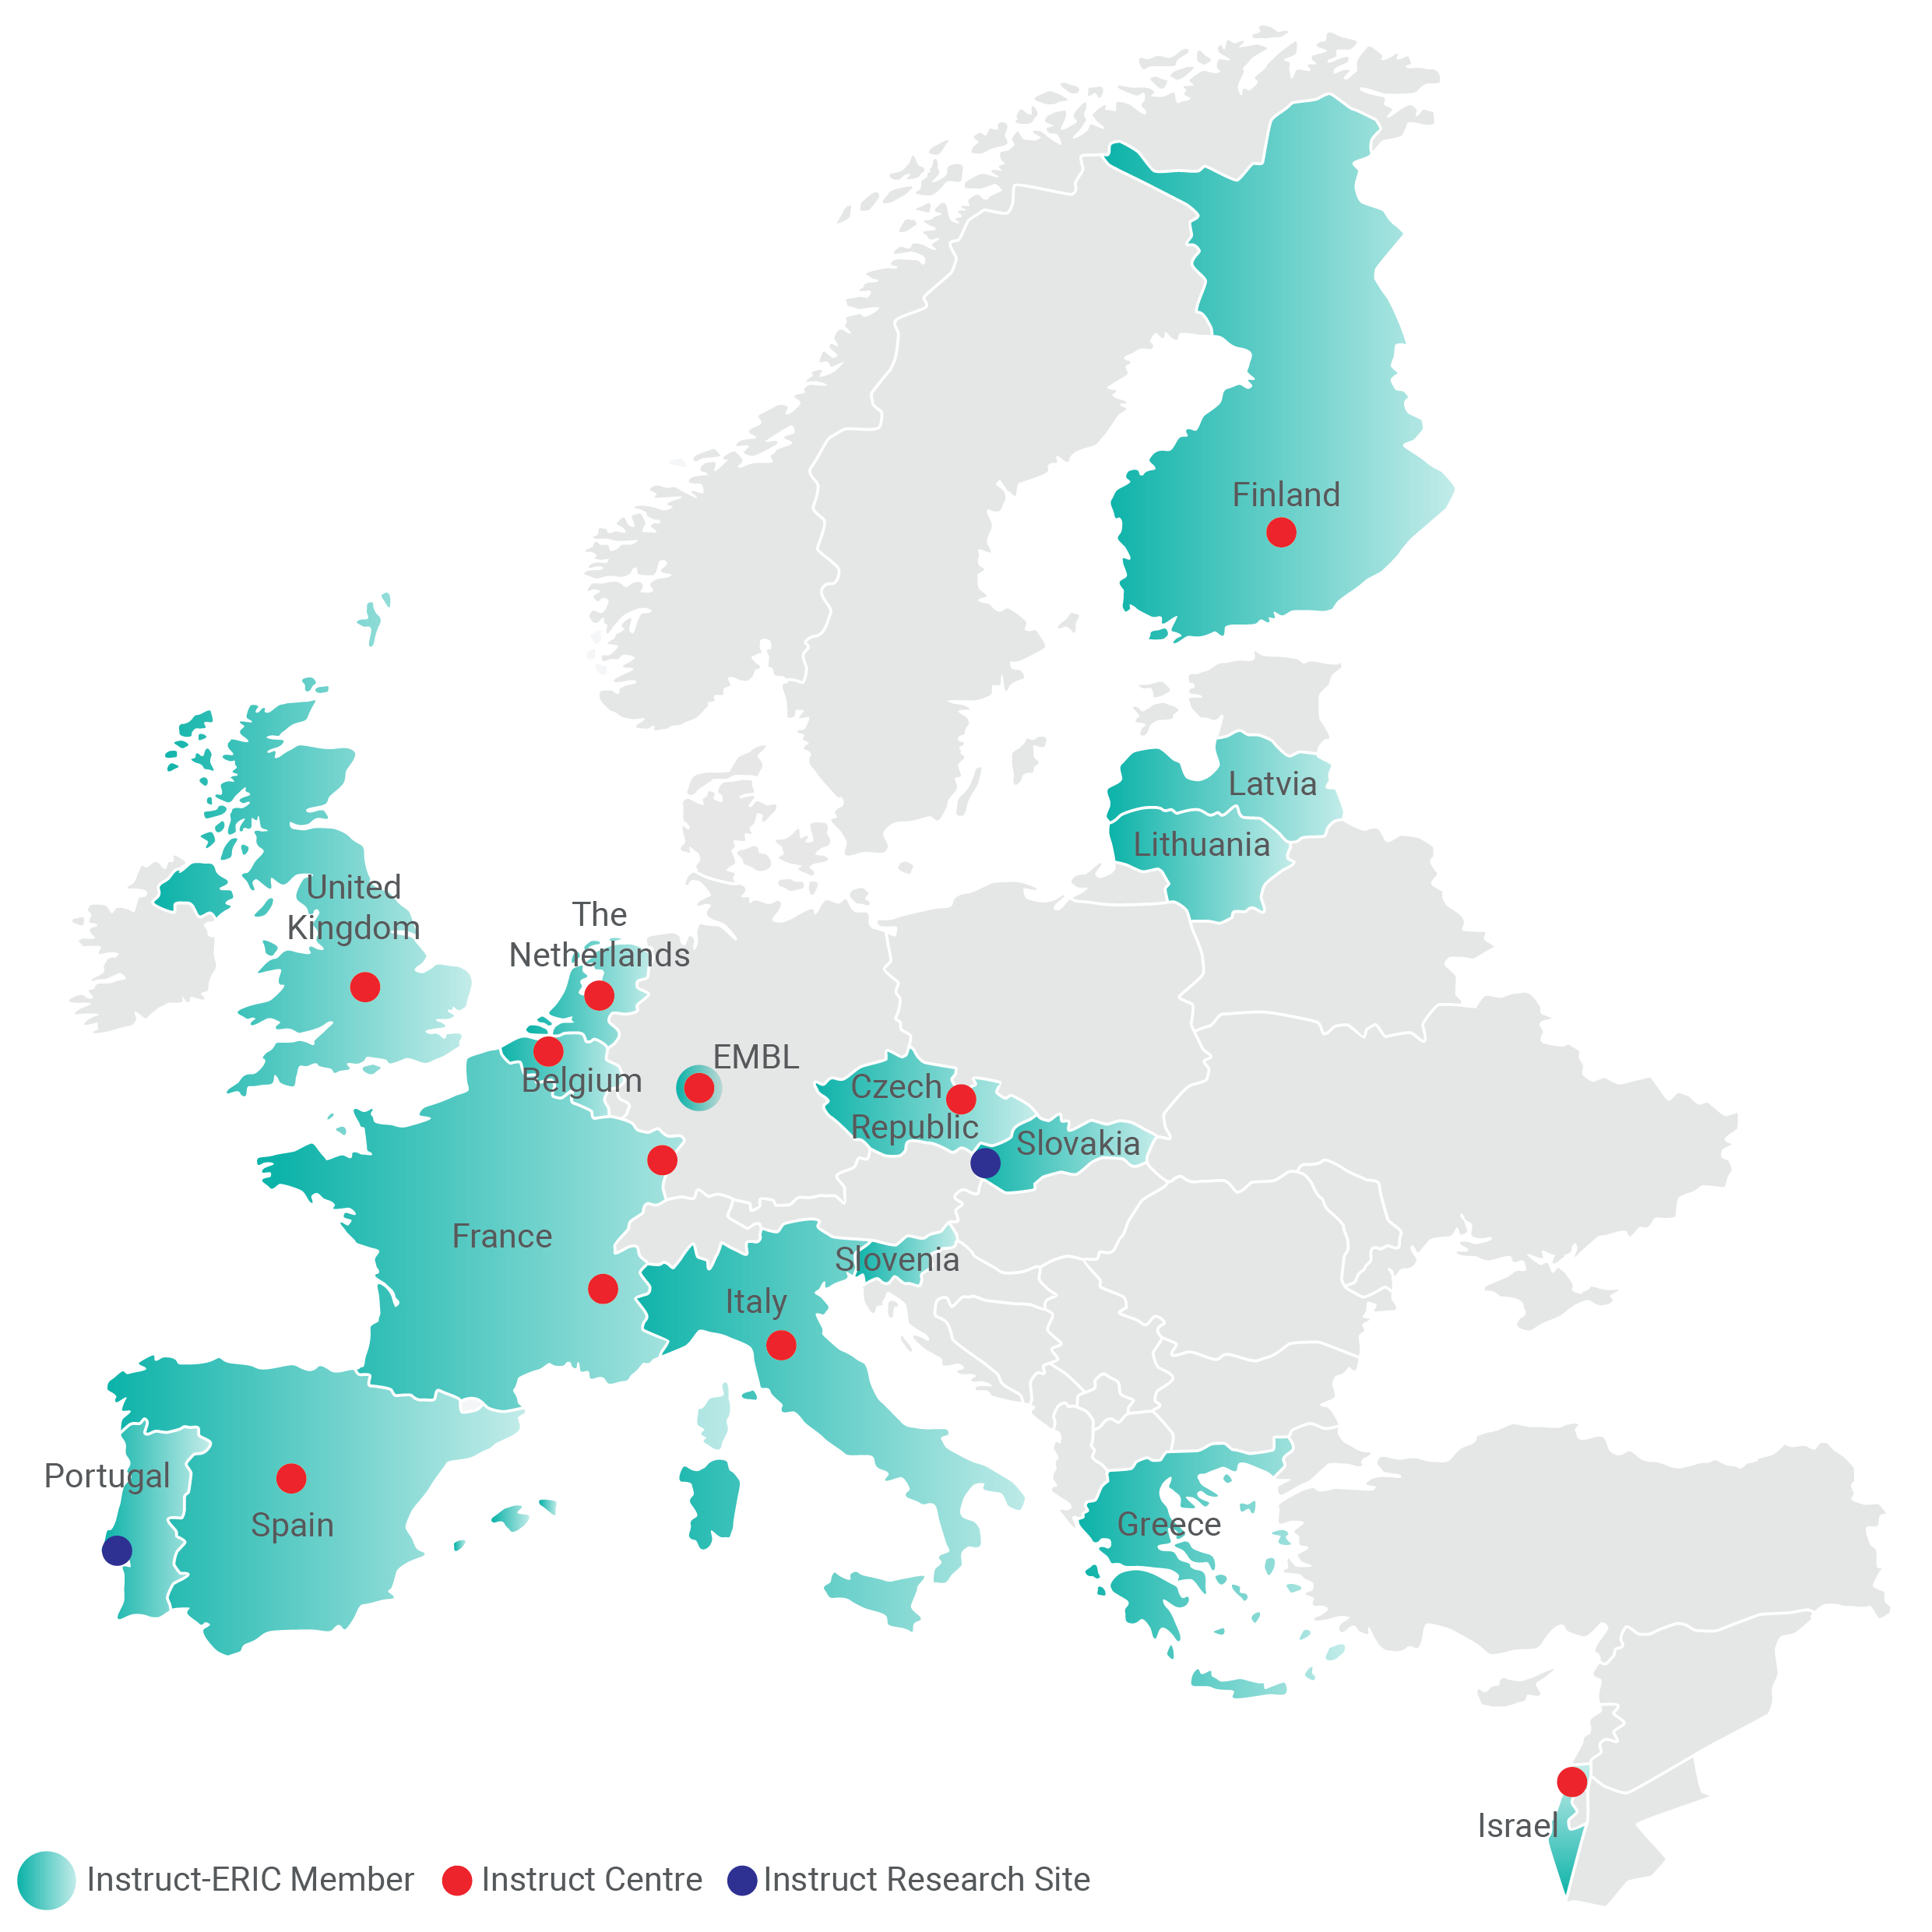
What is Instruct-ERIC?
Instruct-ERIC is the single point of access to technology and expertise for structural biology research.
Instruct has 16 Members that each pay an annual subscription to allow their scientists to access the range of services that are available through the 11 centres of Instruct.

